Slide 1
Chapter 01 Science Inquiry
Scientific Method
Planning an Investigation

Slide 2
Scientific Method
A way to investigate, that allows accurate assessment of whether a hypothesis is supported by the data, incorrect or inconclusive.
Each experiment/investigation adds a small piece to a much larger body of knowledge.

Slide 3
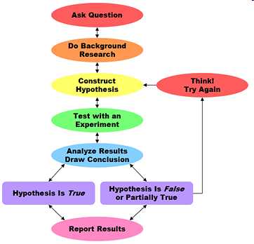

Slide 4

Literature Review
Reading previous research about
the subject.
Helps to define the problem/question
Prevents unnecessary duplication – can build on prior knowledge.
To assess research methods used, and learn from these
Helps scientists to related findings to prior body of knowledge
Allows consideration of areas for further research

Slide 5

Safety
Important to consider safety of research team and participants.
Protective clothing
Ensuring participants feel safe and comfortable
Access to medical care/first aid if needed

Slide 6

Ethics
A set of moral principles. For experiments involving people:
Voluntary participation
Informed consent
No risk of harm
Confidentiality
For animal research:
Valid
Humane
Justifiable
Considerate

Slide 7
Selecting Variables
Should be linked to hypothesis being tested.
Independent Variable: the thing being changed.
Dependent Variable: the thing that changes in response.
Should be:
Measurable
Clear
Other variables should be controlled (kept the same)
Control Sample: a sample where the independent variable is not changed. Used as a comparison

Slide 8
Experimental Validity
Validity:
how well the experiment tests what it is supposed to test
whether the results are accurate
How confident you can be about the conclusions drawn.

Slide 9

Valid experiments:
Have all variables well controlled, except for the IV and DV being tested.
Have a neutral control sample to compare.
Have variables that are measurable/quantifiable
This allows us to be confident that any change to the DV must be due to the IV, and not another factor.

Slide 10
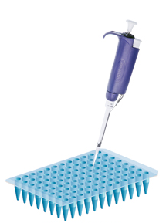
Valid experiments:
Are RELIABLE.
Reliability:
confidence that the results will show the same thing each time the experiment is run.
Helped by large sample sizes, repeated trials.
Can help overcome problems with uncontrolled variables/outliers in the results.

Slide 11
Valid experiments:
Minimise error
Error: mistakes that affect results:
Human Error: data entry mistakes, misreading equipment etc.
Systematic Error: mistakes in experimental design
Random Error: unpredictable eg environmental conditions

Slide 12
Valid experiments:
Avoid bias:
Scientists try to be objective.
Try not to let their own thoughts, feelings and opinions to influence their experiment
Keep an open mind about what the results may be
Try not to have conflict of interest eg: accepting money or favours for the result to be a certain way.
Allow other scientists to review their experimental design, results and conclusions.

Slide 13
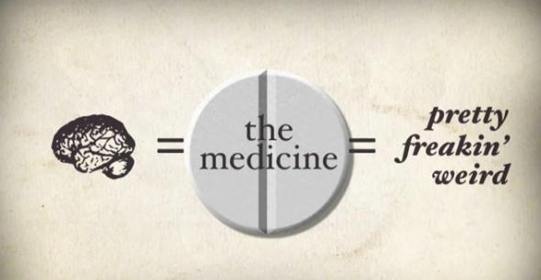
The placebo effect
Is a type of bias that can occur
“trick of the mind”
Scientists or experiment participants may unconsciously introduce bias into the results.
Eg: people receiving a medication may believe they will get better, and therefore report feeling better even if the symptoms don’t go away.

Slide 14
Avoiding placebo effect
Blind studies:
Neither the test group nor the controls know whether they are getting the drug or the placebo.
Double Blind studies:
None of the people being tested, the control group, OR the scientist know which group is getting the drug and which group is getting the placebo until after the experiment.

